Slide 1
Full Remote Learning – Group D
Parent Information Session
Tuesday, September 1, 2020
12 pm

Slide 2
As we return to school, instruction for all of our students
needs to focus on these key elements:​
​
Knowing Students Well​
Integrate Academic and Social Emotional Learning​
Ensure Continuity of Learning​
Focus on Priority Learning

Slide 3
Public School 174 – September 2020 September 1, 2020
 | Monday | Tuesday | Wednesday | Thursday | Friday
6 Planning for Staff | 7 | 8 Teachers Return | 9 10 11 T e a c h e r P la n n i n g |  |  | The pattern will continue for subsequent months. All Cohorts A BC may change to D Remote group at any time. Changing from D Remote to Blended learning will only be offered for November return to Blended learning. *Holidays will be scheduled on NYC Calendar when public
13 All students Remote | 14 15 T e a c h e r P la n n i n g |  | 16 First Day All Students A B C D Remote | 17 A B C D Remote | 18 A B C D Remote
20 Rotation for Groups Begins | 21 Group A in person B C D Remote | 22 Group B in person A C D Remote | 23 Group A in person B C D Remote | 24 Group B in person A C D Remote | 25 Group C in person A B D Remote
27 Rotation for Groups | * Yom Kippur 28 Group B in person A C D Remote Yom Kippur * | 29 Group C in person A B D Remote | 30 Group A in person B C D Remote | October 1 Group B in person A C D Remote | October 2 Group C in person A B D Remote

Slide 4
Learning Fully Remote – Group D
Google Classrooms
Students are assigned Google logins
Daily schedule in advance. Teachers will
reach out prior to start of school.
Live teaching includes Student participation.
Also Recordings such as readalouds and Flipgrids.
Parent Engagement –
For teacher/ parent time – 20 minutes daily by appointment.
How to Prepare for “At Home” Learning—
Find a place/corner in the home—away from tv or distractions.
Try to create that routine.
Setup the laptop or ipad (please request device from DOE); headphones
Setup the study area with school supplies, pencils, paper, stickers, etc.
It’s Ok to- Take stretch breaks, crazy dance breaks, sing a song break during the asynchronous times!

Slide 5
How does our day begin with fully Remote Learning?
Flexible time during the day beginning with a morning Meeting
with the class on Google Classroom. All students are seen on the screen.
There will be time with scheduled (synchronous) learning and
off screen (asynchronous) learning for age specific times.
Synchronous – (live instruction)
Whole class, small group or individual students live instruction.
Content specific; or social emotional activities.
Individual feedback.
Scheduled in advance.
Asynchronous – Occurs daily and serves as supplemental work. Students are working on learning activities at their own pace at a flexible time.
Video lessons or recordings
Flipgrid
Discussion boards
Google slides; worksheets; written feedback on Google Classroom
iReady, Imagine Learning, Epic!, Read Me A Story; et al.

Slide 6
REMOTE TEACHING AND LEARNING GRADES K-2

Slide 7
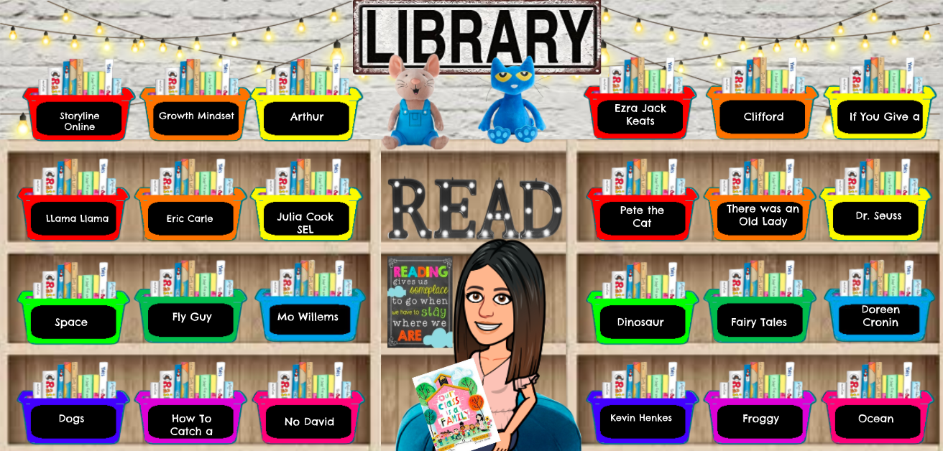
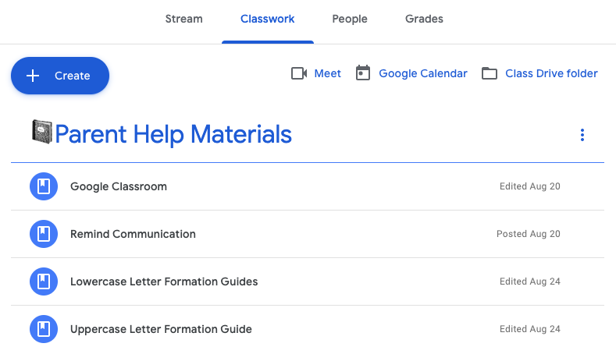
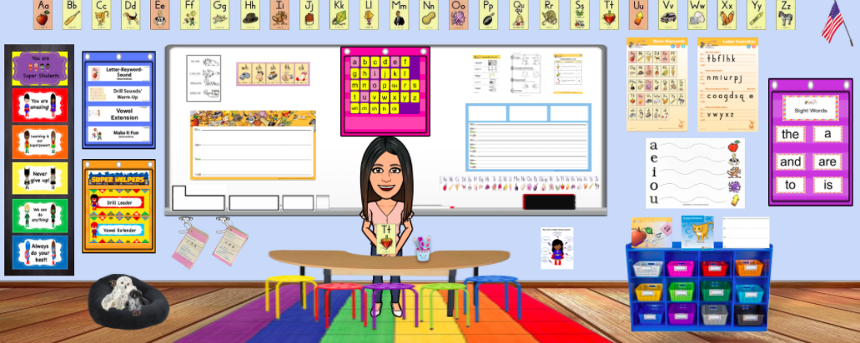
What will a remote Google classroom look like?

Slide 8
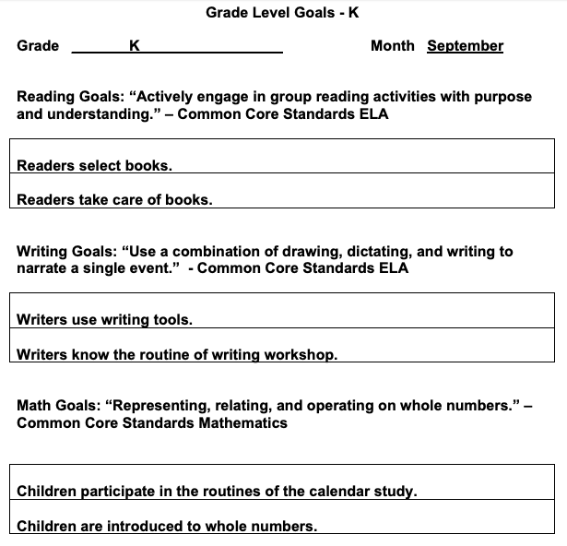
September Goals
You can find the Grade goals for each
month of the year on our school website:
http://www.ps174.org

Slide 9
School Supplies
Headset or earbuds
Crayons
Markers
Pencils sharpened 6
Composition books 2
Folders (2 pocket) 2 to keep papers in order
Small box (to put pencils, scissors)
Art supplies/STEM supplies to be determined
and shared by the Teachers.

Slide 10
You will be given instructions to join your child’s REMIND group the first week of school. It’s very important you join to get updates and notifications from Principal Kelly and your child’s teachers (both in-person and remote).
Separate remind groups for remote learning from your teacher(s) or Mrs. Kelly. Messages are set up for texts. Add your full name and child’s name. Select Parent as Role.
This is our form of communication at P.S. 174.

Slide 11
Questions?

